Slide 1

Hospital Cost Efficiency Analysis
IDC6940 - Capstone In Data Science
max growth
Student
Rolf Kinder Gilet
Faculty Mentors
Dr. Kalai Mathee
Dr. Alejandro Arrieta
Faculty Advisor
Dr. Giri Narasimhan

Slide 2
Motivation
The United States spends the most on healthcare
$1.1 million dollar bill sent to Michael Flor
Administrative complexity
Efficiency
Notes:
While the cost of healthcare has been rising consistently for consumers. Primary care visits and procedures that we used to pay less than $100 for are now costing us in the hundreds. This situation has made it hard for most Americans to meet their healthcare needs.
Spent 62 days with COVID-19
In a Swedish Medical Center in Issaquah

Slide 3
Questions And Goals
Administrative complexity and service cost
Hospital efficiency confounding variables
Location
Size
Demography
Calculate hospital efficiency score
Optimize efficiency score
Reduce hospital waste in administrative cost

Slide 4
Raw Data Set
Data source
Centers for Medicare & Medicaid services (CMS)
Link Data set : Hospital cost data package
Scope
2010 to 2021
Size
5,520 variables
63,435 rows
6,802 hospitals
Notes:
Grouped in
Salary cost, maintenance cost, administrative cost, building management repair cost, patient records management cost, patient service cost, hours work and various other forms

Slide 5
Hospital Types
Hospital Type Code | Description
1 | General Short Term
2 | General Long Term
3 | Cancer
4 | Psychiatric
5 | Rehabilitation
6 | Religious Non-Medical Healthcare Institution
7 | Children
8 | Alcohol And Drug
9 | Other
10 | Extended Neoplastic Disease Care
11 | Indian Health Service

Slide 6
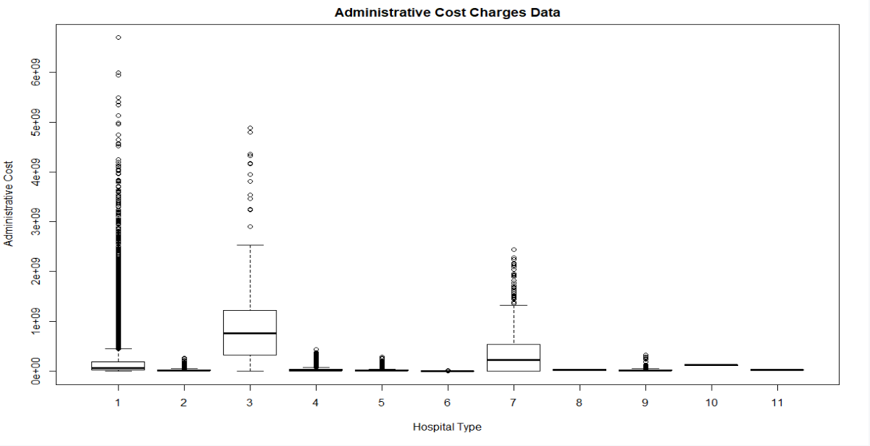
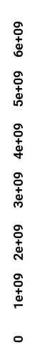
Hospital Type Volatility
Administrative cost charges data
Administrative Cost
Hospital Type
Notes:
Hospital type 1 is our focus since it has the highest volatility when it comes to administrative cost

Slide 7
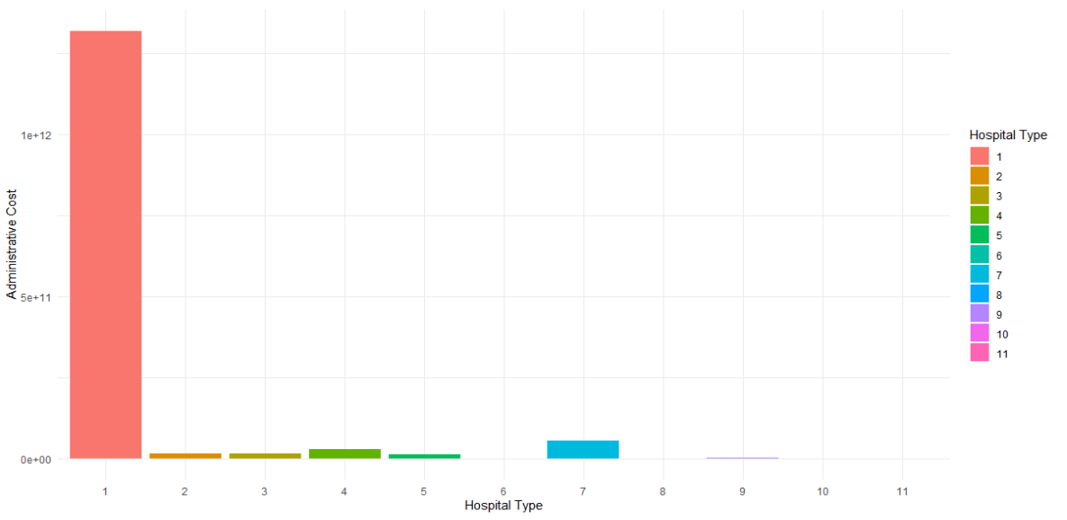
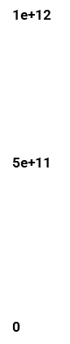
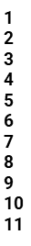
Hospital Administrative Cost By Type
Hospital Type
Administrative Cost
Hospital Type
Notes:
Hospital type 1 has the highest cost when it comes to administration

Slide 8

Hospital Type 1 Grouping
Low complexity
1 to 2
Moderate complexity
3 to 5
High complexity
6+
Notes:
Grouping hospital type 1 which is general short-term hospital by number of specialty to determine how complex their daily operation is

Slide 9

Standardized Data Set
Form worksheet B1
Dropped 2010 and 2021 (Incomplete)
Used 2011 to 2020 data:
6,784 hospitals
61,061 rows
202 variables/columns
Notes:
CMS Hospital 2552-10 form
Worksheet B1 is the form where CMS hospitals reports the cost related to their administration on an annual or quarterly basis
We used Cost Report data website to get Worksheet B1 filling instruction, Data Dictionary and missing information to help us digest the data
Dropped 2010 ( 2323 hospitals ) and 2021 (51 hospitals)
2010 and 2021 data are missing about 60% of the hospitals.

Slide 10
Input Variables — General Service Cost Centers
Capital Related Costs-Buildings and Fixtures
Capital Related Costs-Movable Equipment
Employee Benefits Department
Administrative and General
Maintenance and Repairs
Operation of Plant
Laundry and Linen Service
Housekeeping
Dietary
Cafeteria
Maintenance of Personnel
Nursing Administration
Central Services and Supply
Pharmacy
Medical Records & Medical Records Library
Social Service
Other General Service (specify)
Nonphysician Anesthetists
Nursing Program
Intern & Res. Service-Salary & Fringes (Approved)
Intern & Res. Other Program Costs (Approved)
Paramedical Education Program (specify)
Notes:
22 Inputs

Slide 11

Output Variables
Number of Patients (Admission)
Number of Beds
Number of Inpatient Discharges
Number of Outpatient Discharges
Notes:
4 Outputs

Slide 12

Methodology
Data envelopment analysis
Stochastic frontier analysis
Combination of DEA and SFA
Best-of-two Method
Mean Method
Notes:
Developing Data envelopment Analysis
We want to use DEA to empirically measure productive efficiency of decision making units (DMUs) for hospitals. With that done we will be able to create hour Hospital Efficiency Metric
As none of the methods is in all respects superior, in real world applications, it is regarded as “best-practice” to combine the estimates obtained from DEA and SFA. Hence in a second step, we compare the approaches to transforming the estimates into efficiency scores, with the elementary estimates of the two methods.
Our results demonstrate that combination approaches can actually constitute “best-practice” for estimating precise efficiency scores.
(see e.g. Haney and Pollitt (2009)). In addition to this observation of real-world application, in the efficiency analysis literature, researchers also assume, that the use of more than one method could help to avoid the occurrence of “methodological bias” (see, for example, Banker et al. (1994)).
Andor, M. (2009). Die Bestimmung von individuellen Effizienzvorgaben - Alternativen zum Best-of-Four-Verfahren. Zeitschrift f¨ur Energiewirtschaft, 3:195–204.
Andor, Mark A. & Parmeter, Christopher & Sommer, Stephan, 2019. "Combining uncertainty with uncertainty to get certainty? Efficiency analysis for regulation purposes
Haney, A. and Pollitt, M. (2009). Efficiency analysis of energy networks: An international survey of regulators. Energy Policy, 37(12):5814–5830.

Slide 13
Data Envelopment Analysis
A nonparametric technique
Linear programming
Evaluate efficiency of organizations in the same industry
Constant returns to scale (CRS)
Variable returns to scale (VRS)
Notes:
DEA can be described as a nonparametric technique based on linear programming to evaluate the efficiency of organizations working in the same industry, for example, schools, banks, factories and utilities
Nonparametric statistics is based on either being distribution-free or having a specified distribution but with the distribution's parameters unspecified
Developing Data envelopment Analysis
We want to use DEA to empirically measure productive efficiency of decision making units (DMUs) for hospitals. With that done we will be able to create hour Hospital Efficiency Metric

Slide 14
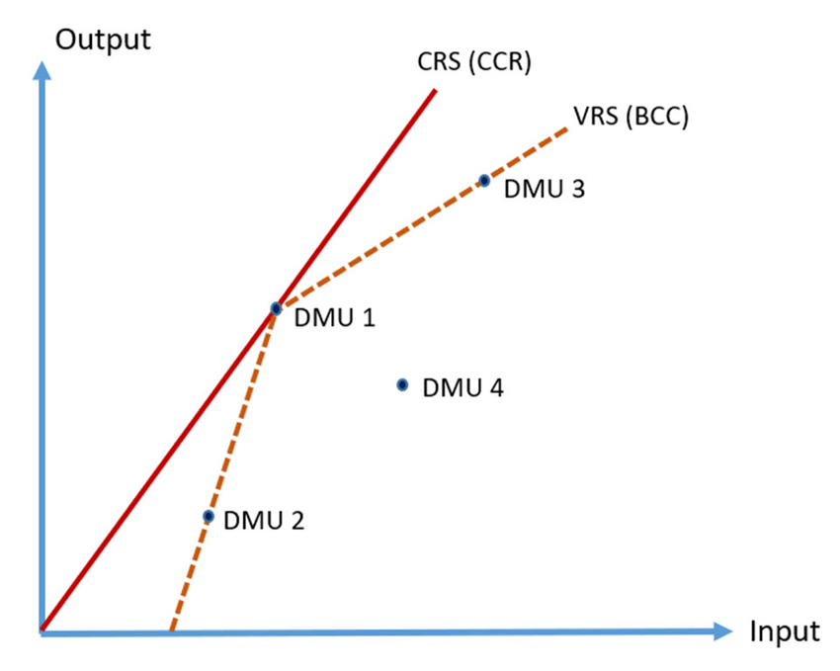
Constant Returns to Scale (CRS)
Output will change by the same proportion as inputs
Constant
Notes:
DEA can be described as a nonparametric technique based on linear programming to evaluate the efficiency of organizations working in the same industry, for example, schools, banks, factories and utilities
Nonparametric statistics is based on either being distribution-free or having a specified distribution but with the distribution's parameters unspecified
Developing Data envelopment Analysis
We want to use DEA to empirically measure productive efficiency of decision making units (DMUs) for hospitals. With that done we will be able to create hour Hospital Efficiency Metric

Slide 15
Variable Returns to Scale (VRS)
Increase or decrease in input or outputs
Not a proportional change in the outputs or inputs
Notes:
DEA can be described as a nonparametric technique based on linear programming to evaluate the efficiency of organizations working in the same industry, for example, schools, banks, factories and utilities
Nonparametric statistics is based on either being distribution-free or having a specified distribution but with the distribution's parameters unspecified
Developing Data envelopment Analysis
We want to use DEA to empirically measure productive efficiency of decision making units (DMUs) for hospitals. With that done we will be able to create hour Hospital Efficiency Metric

Slide 16
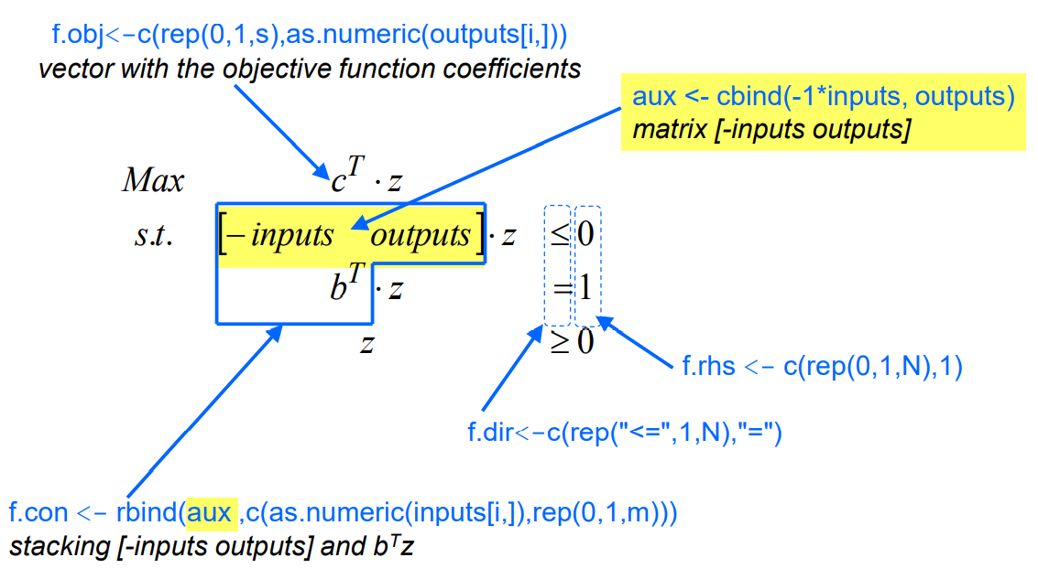

Data Envelopment Analysis
Notes:
DEA can be described as a nonparametric technique based on linear programming to evaluate the efficiency of organizations working in the same industry, for example, schools, banks, factories and utilities
Developing Data envelopment Analysis
We want to use DEA to empirically measure productive efficiency of decision making units (DMUs) for hospitals. With that done we will be able to create hour Hospital Efficiency Metric
DEA optimizes an efficiency index which is formed by a weighted sum of outputs divided by a weighted sum of inputs from all operating units.

Slide 17
Data Envelopment Analysis
require(lpSolve)
results <- lp("max",as.numeric(f.obj),f.con,f.dir,f.rhs,scale=0,compute.sens=TRUE)
multipliers <- results$solution
efficiency <- results$objval
lambdas <- results$duals[seq(1,N)]
Notes:
lpSolve Package
Lp ( linear programing to resolve the matrix of the input and output
Multipliers are u and v from the equation
Efficiency is theta from the equation ( which is our goal)
Lambdas is the raw weights assigned to the Decision making UNITS when solving the DEA model.

Slide 18
Data Envelopment Analysis CRS
f.rhs <- c(rep(0,1,N),1)
f.dir <- c(rep("<=",1,N),"=")
aux <- cbind(-1*inputs,outputs)
#loop of N DMUs
for (i in 1:N) {
f.obj <- c(0*rep(1,s),as.numeric(outputs[i,]))
f.con <- rbind(aux ,c(as.numeric(i?puts[i,]), rep(0,1,m)))
results <- lp ("max",as.numeric(f.obj), f.con, f.dir, f.rhs,scale=0, compute.sens=TRUE)
if (i==1) {
weights <- results$solution
effcrs <- results$objval
lambdas <- results$duals[seq(1,N)]
} else {
weights <- rbind(weights, ?esults$solution)
effcrs <- rbind(effcrs , results$objval)
lambdas <- rbind(lambdas, results$duals[seq(1,N)] )
}
}

Slide 19
Data Envelopment Analysis VRS
f.rhs <- c(rep(0,1,N),1)
f.dir<-c(rep("<=",1,N), "=")
aux <- cbind(-1*inputs,outputs,1,-1)
for (i in 1:N) {
f.obj<-c(rep(0,1,s),as.numeric(outputs[i,]),1,-1)
f.con <- rbind(aux,c(as.numeric(inputs[i,]),rep(0,1,m),0,0))
results <- lp ("max",as.numeric(f.obj), f.con, f.dir? f.rhs,scale=1, compute.sens=TRUE)
multipliers <- results$solution
u0 <- multipliers[s+m+1]-multipliers[s+m+2]
if (i==1) {
weights <- c(multipliers[seq(1,s+m)],u0)
effvrs <- results$objval
lambdas <- results$duals[seq(1,N)]
} else {
weights<-rbin?(weights,c(multipliers[seq(1,s+m)],u0))
effvrs <- rbind(effvrs , results$objval)
lambdas <- rbind(lambdas,results$duals[seq(1,N)])
}
}
Notes:
#The differe?ce between CRS and VRS models resides in the unconstrained variable u0
#This variable can be modeled by the difference of two non negative variables (u0 = u+ - u- , where u+ >= 0 and u- >=0)
# 1 and -1 represents u+ - u-
DEA can be described as a nonparametric technique based on linear programming to evaluate the efficiency of organizations working in the same industry, for example, schools, banks, factories and utilities
Developing Data envelopment Analysis
We want to use DEA to empirically measure productive efficiency of decision making units (DMUs) for hospitals. With that done we will be able to create hour Hospital Efficiency Metric

Slide 20
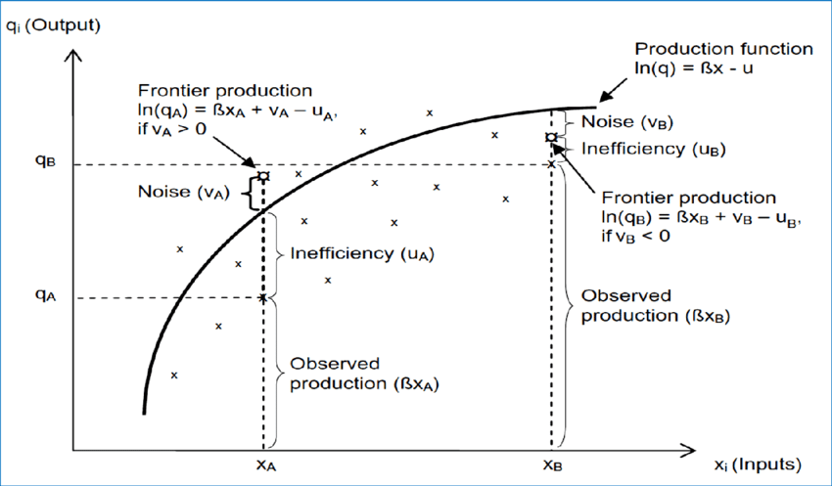
Stochastic Frontier Analysis
A parametric approach
Method of economic modeling
Evaluate productivity and efficiency
Explicitly account for inefficiency
Notes:
Has been applied to study the productivity and efficiency of production units in various economic sectors
assumes that most DMU are either on or very close to the efficiency frontier. Inefficiency—being away from the frontier
Parametric analysis is a branch of inferential statistics wherein one obtains a sample from a population in order to estimate population parameters
the stochastic frontier framework involves two steps.
In the first, the frontier model is estimated, usually by maximum likelihood. In the second, the
estimated model is used to construct measures of inefficiency or efficiency. Individual specific
estimates are computed that provide the basis of comparison of firms either to absolute standards or
to each other.

Slide 21
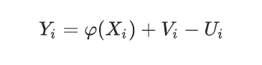
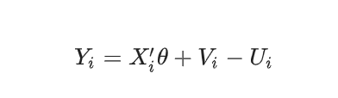
Stochastic Frontier Model (SFM)
A (parametric) linear SFM
Notes:
y is a result,
X is a input
φ(x) is the frontier value
V being a symmetric random noise (variable)
We can use Linear Programing to resolve the equation
We used
library('lpSolve') # load lpSolve package
library('micEcon')
library('frontier')
As Ui “captures” technology inefficiency of firm i, we would like to “estimate” it, from observations across firms (Xi, Yi), i ∈ I. However, like V, U is not observable! However, if we could estimate θ, by some estimation method, then we can compute the estimated residuals εi = vi − ui by
ε^i=yi−xi′θ^
which are values of the random variable V − U Thus, in MSE sense, the best predictor of Ui is
E(Ui|Vi−Ui=ε^i).

Slide 22

Efficiency and Inefficinecy Ranges
Efficient
Score of 0.8 to 1
Inefficient
Score of 0 to 0.79

Slide 23
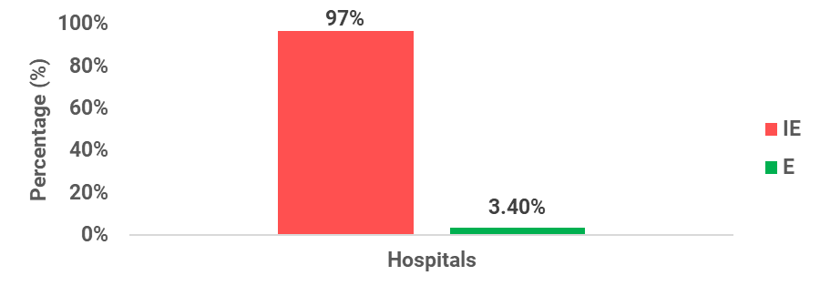
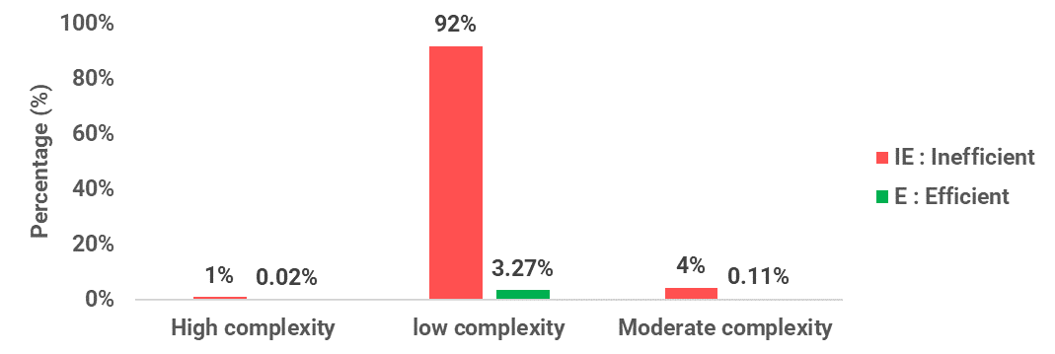
Efficiency (2011 to 2020)
Notes:
Efficiency % graph represent the % of Efficient and Inefficient hospitals in our data set

Slide 24
Administrative Complexity Level
Notes:
Efficiency % graph represent the % of Efficient and Inefficient hospitals in our data set

Slide 25
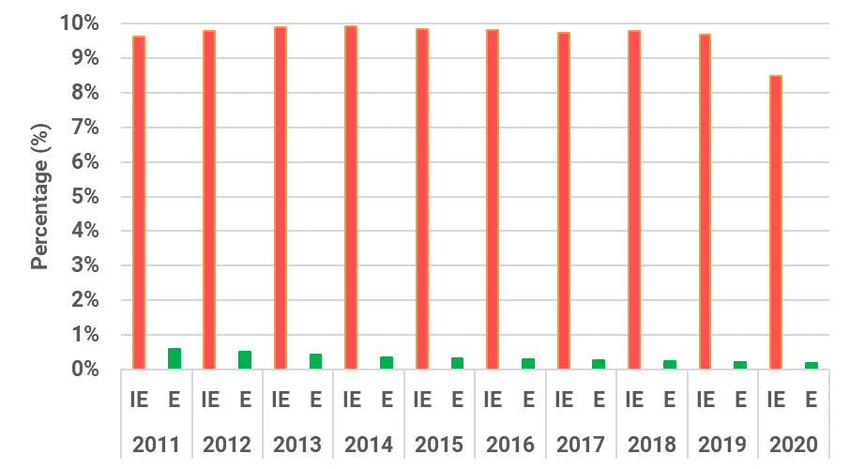
Annual Efficiency % (2011 to 2020)
Notes:
Annual Efficiency Breakdown

Slide 26
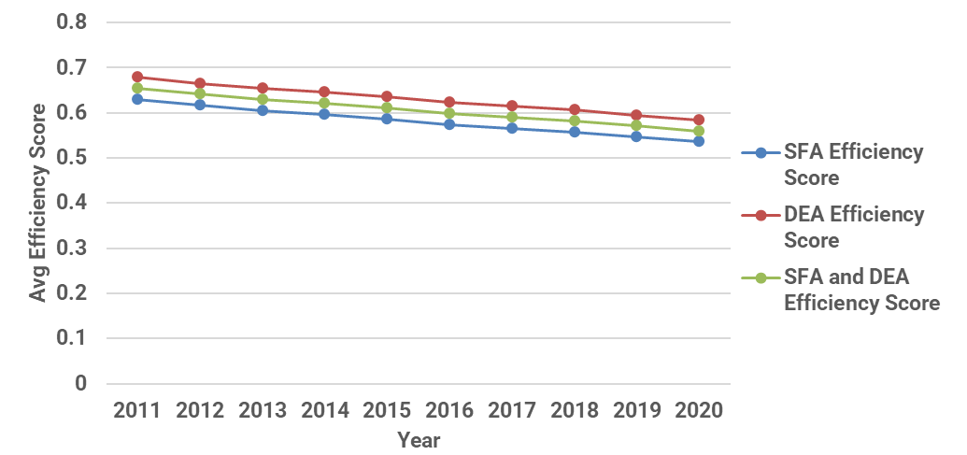
Hospitals Annual Efficiency Trends
Notes:
Annual Efficiency Trends

Slide 27
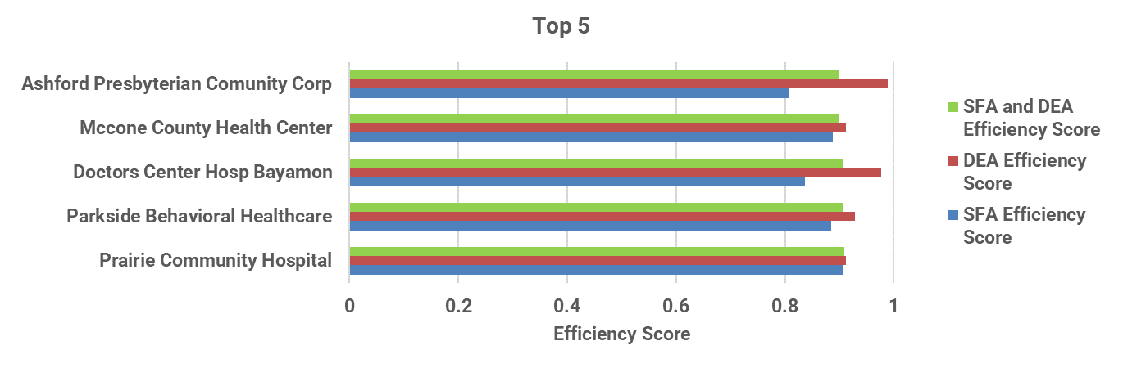
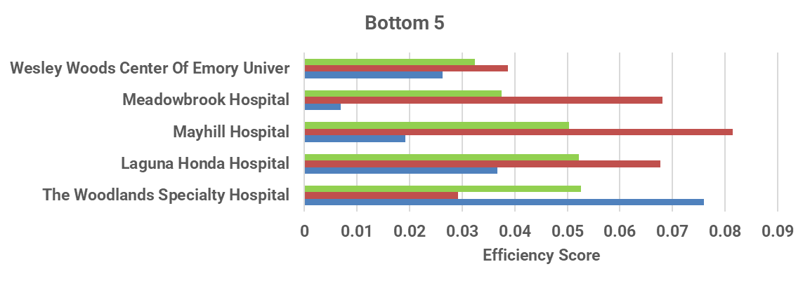
Top 5 Vs Bottom 5 Inefficient Hospitals
Notes:
Difference between top 5 and bottom 5 is grand. Bottom 5 efficiency are lower than 0.1

Slide 28
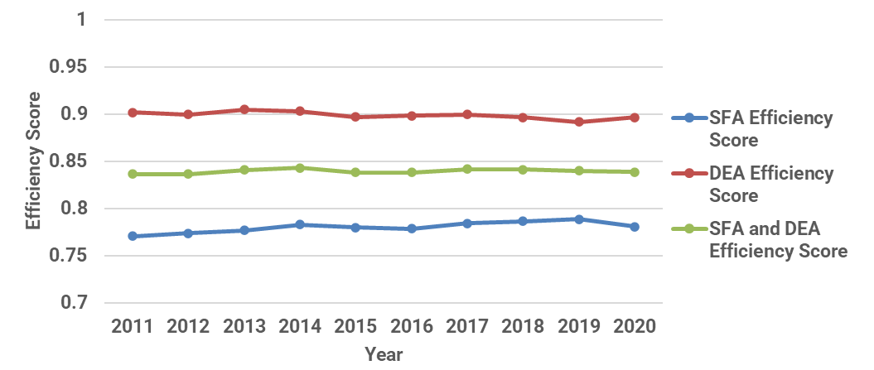
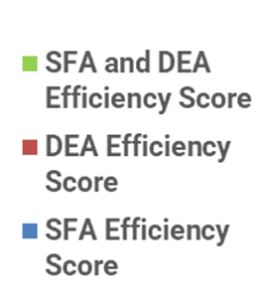
Efficient Hospitals Annual Trends
Notes:
Efficient Hospitals Annual Trends

Slide 29
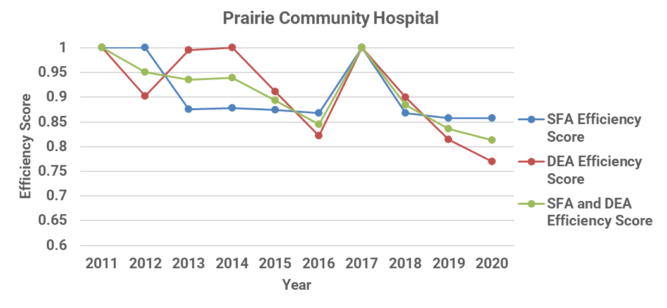
Top Efficient Hospital Annual Trends
Notes:
Top Performing Hospital Annual Trends
PRAIRIE COMMUNITY HOSPITAL
Is located in montana ,
Total Administrative is around 2 M
They are part of our Low complexity hospitals with specialty counts below 3
They have In patient outpatient Discharges averaging 10 plus thousands respectively
With a bed capacity of 22 with a bed occupancy averaging 78 to 80%

Slide 30
Observation
95% of hospitals have low efficiency
5% of hospitals have high efficiency
Low efficiency hospitals
High administrative costs
Low outputs
High efficiency hospitals
Low administrative costs
High outputs

Slide 31
Summary
Literature review waste in healthcare
CMS hospital SAS data cleanup and staging
Data enrichment
Implement DEA and SFA
Merge DEA and SFA efficiency score
CMS hospital efficiency 10 years decline
5 % of CMS hospitals are efficient

Slide 32
Future Work
Increased hospital efficiency
Reduce Input while preserving output
Reduce Input while Increasing output
Expand hospital and input choices
Notes:
Could expand data set beyond cms hospitals
Could model input reduction while preserving output (performance)

Slide 33
Thank You!

